Slide 1
Machine Learning in the Housing Market
By: Daisy K., Miguel G., Vandrea F.
Notes:
Daisy

Slide 2
Overview
In today's dynamic housing market, making informed decisions about buying, selling, or investing in properties is more critical than ever. Traditional methods struggle to keep up with the ever-changing factors influencing real estate values.
Enter machine learning: a cutting-edge technology poised to revolutionize the way we understand, navigate, and predict housing market trends. By harnessing the power of historical housing census data, demographics, location, and size; machine learning algorithms can offer unparalleled accuracy in property valuation and recommendations.
Our mission is to explore the potential of machine learning in housing analytics, unearthing hidden insights and empowering individuals and businesses to make smarter real estate choices.
Notes:
Daisy

Slide 3
DataSet Insights
The data pertains to the houses found in a given California district and some summary stats about them based on the 1990 census data
The dataset contains information on block groups in California and 10 measures, including longitude, latitude, housing median age, total rooms, total bedrooms, population, households, median income, median house value, and ocean proximity
The financial crisis of the early 1990s was brought on by a cyclical real estate bubble. One of the causes of the 1990 recession was how household debt and house flipping drove prices up too high. When adjustable interest rates kicked in, many people defaulted on their mortgage loans, signaling the crash.
Notes:
Miguel
Our dataset columns pertained:
1. longitude: A measure of how far west a house is; a higher value is farther west
2. latitude: A measure of how far north a house is; a higher value is farther north
3. housingMedianAge: Median age of a house within a block; a lower number is a newer building
4. totalRooms: Total number of rooms within a block
5. totalBedrooms: Total number of bedrooms within a block
6. population: Total number of people residing within a block
7. households: Total number of households, a group of people residing within a home unit, for a block
8. medianIncome: Median income for households within a block of houses (measured in tens of thousands of US Dollars)
9. medianHouseValue: Median house value for households within a block (measured in US Dollars)
10. oceanProximity: Location of the house w.r.t ocean/sea

Slide 4
Preprocessing
In our journey to building machine learning models, we took extra steps in preparing our dataset.
Two key techniques we employed were "One-Hot Encoding" and "Train-Test Split." - This helps us assess how well our model generalizes to new, unseen data and avoids overfitting.
By employing One-Hot Encoding, we've made our categorical data machine-friendly, and through Train-Test Split, we've set the stage for model evaluation.
Notes:
Miguel
(incase they ask for further details for one hot encoding / train-test split: [One-Hot Encoding]
In other words, One-Hot Encoding was used to transform categorical data into a numerical format suitable for our algorithm.
Imagine we have a "Color" feature with categories: Red, Blue, and Green. One-Hot Encoding converts this into binary columns like "Is_Red," "Is_Blue," and "Is_Green."
It prevents the model from assigning ordinal or numerical importance to the categories, ensuring a fair representation.
[Train-Test Split]
Train-Test Split was used to divide our dataset into two subsets: the "Training" set and the "Testing" set.
The "Training" set was used to train our machine learning model, while the "Testing" set was kept aside to evaluate its performance.
This helped us assess how well our model generalizes to new, unseen data and avoids overfitting.
X = df_lending_data.drop(columns=['median_house_value']) = everything but median house value
y = df_lending_data['median_house_value'] = median_house_value which is what were trying to predict
)

Slide 5
Machine Learning Models
In search to find the best model for our dataset, we tested four algorithms:
Linear Regression:
Linear Regression models the relationship between a dependent variable (target) and one or more independent variables (features).
It assumes a linear relationship and tries to fit the best-fitting straight line through the data points.
Suitable for predicting continuous numeric values.
Random Forest Regressor:
Random Forest is an ensemble learning method that combines multiple decision trees to improve prediction accuracy.
It reduces overfitting and increases model stability by averaging predictions from multiple trees.
Great for handling both categorical and numerical features.
Gradient Boosting Regressor:
Gradient Boosting builds an ensemble of decision trees sequentially.
Each tree corrects the errors made by the previous ones, leading to strong predictive performance.
Effective for capturing complex relationships in the data.
K-Nearest Neighbors (KNN) Regressor:
KNN is a non-parametric algorithm that makes predictions based on the similarity of data points.
It calculates the output by averaging the values of its k-nearest neighbors.
KNN is useful for both regression and classification tasks.
Notes:
Daisy
ADD: By testing these diverse algorithms, we aimed to find the best model that suits our dataset and problem. Each algorithm has its strengths and can provide valuable insights into our data.

Slide 6
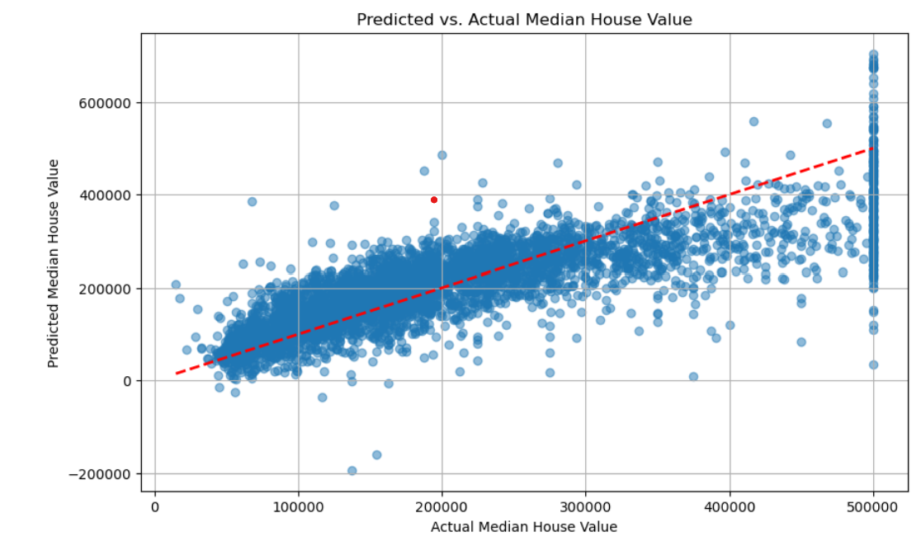
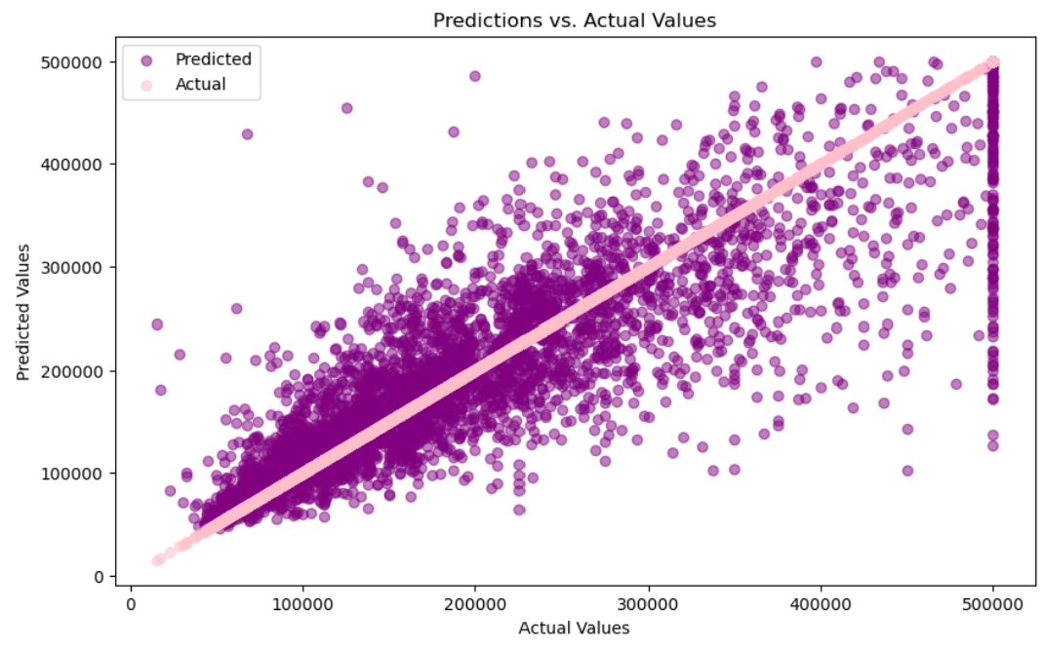
Visuals of Trial and Error
K Nearest Neighbors Regression (below)
R-squared value of 0.7112550471968917
Linear Regression Model (above)
R-squared value of 0.6258771951358701
Notes:
Daisy
For our testing we used the given columns from the dataset except for the median house value to help predict the housing value
Our first try was the Linear Regression model in which was nowhere near sufficient enough for what we were required or looking for, as we can notice the accuracy of the prediction was moving higher from the actual pricing markers as the pricing gets higher in the graphon the graph
so we moved onto using the K Nearest Neighbors Regression Model. This models was better but still below our value goal and again the predicted value was moving higher than the actual value that was given within our dataset

Slide 7
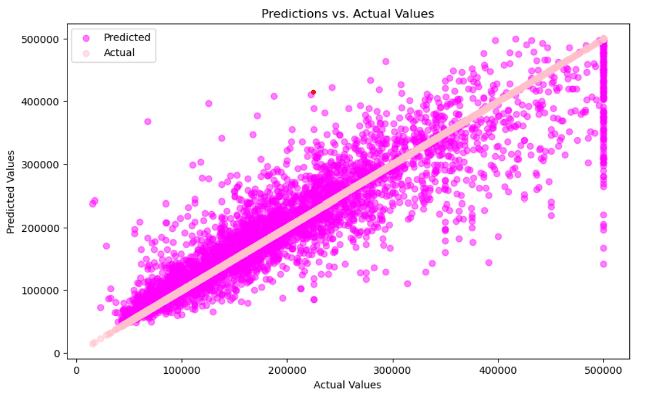
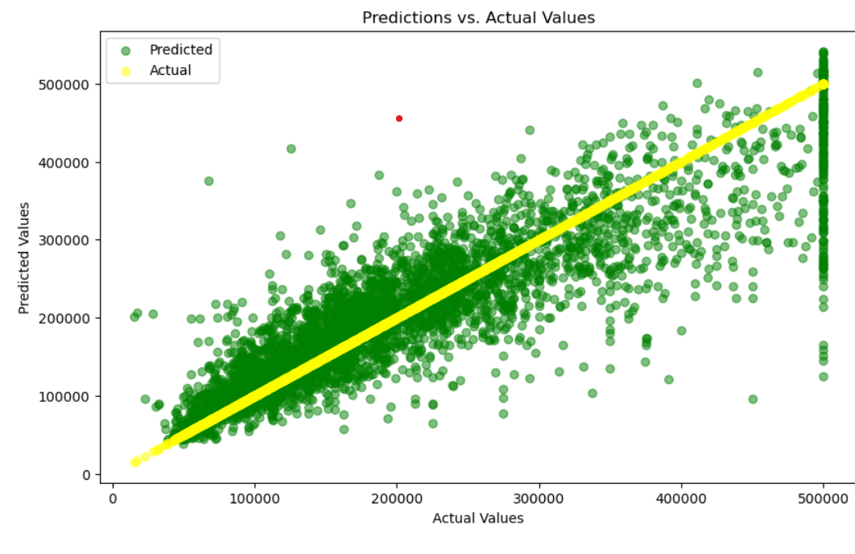
Visuals of Trial and Error Continued..
Gradient Boosting Regressor (below)
R-Squared of 0.7609962615313416
Random Forest Regressor Model (above)
R-Squared of 0.8173290384570426
Notes:
Daisy
For our third try we used the Gradient Boosting Regressor model and while it was still progress from our previous models, again it was NOT GOOD ENOUGH
And finally we tried THE RANDOM FOREST REGRESSOR MODEL which gave us the r-squared value we had been looking for and was on par with the actual data the dataset had given us.
Once we finally found the model that fit our dataset, we believed it was the best fit because of our training columns within our dataset.
Here is a deeper look into our training columns

Slide 8
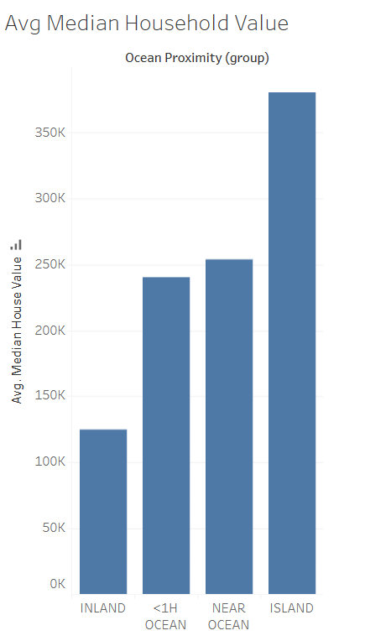
Avg Median Household Value
Using Tableau, this is one of the graphs that we made which show Avg prices:
Island = $380,440
Nearly Ocean = $253,960
<1H Ocean = $240,084
Inland = $124,805
Houses near the ocean tend to be higher in price
Notes:
Drea

Slide 9
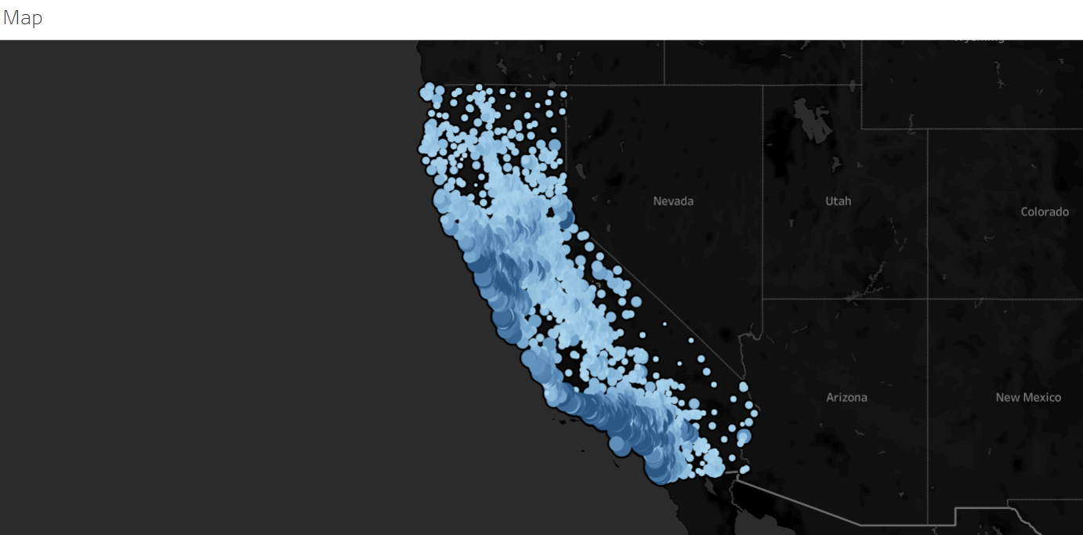
California Housing Map
The map shows median house values throughout California
The higher priced homes are closer to the coast while the lower priced homes are located more inland
The color gradient represents the median household income, with the darker shades showing higher household incomes
Venus
Mars
Despite being red, Mars is actually a cold place. It’s full of iron oxide dust
Notes:
Drea

Slide 10
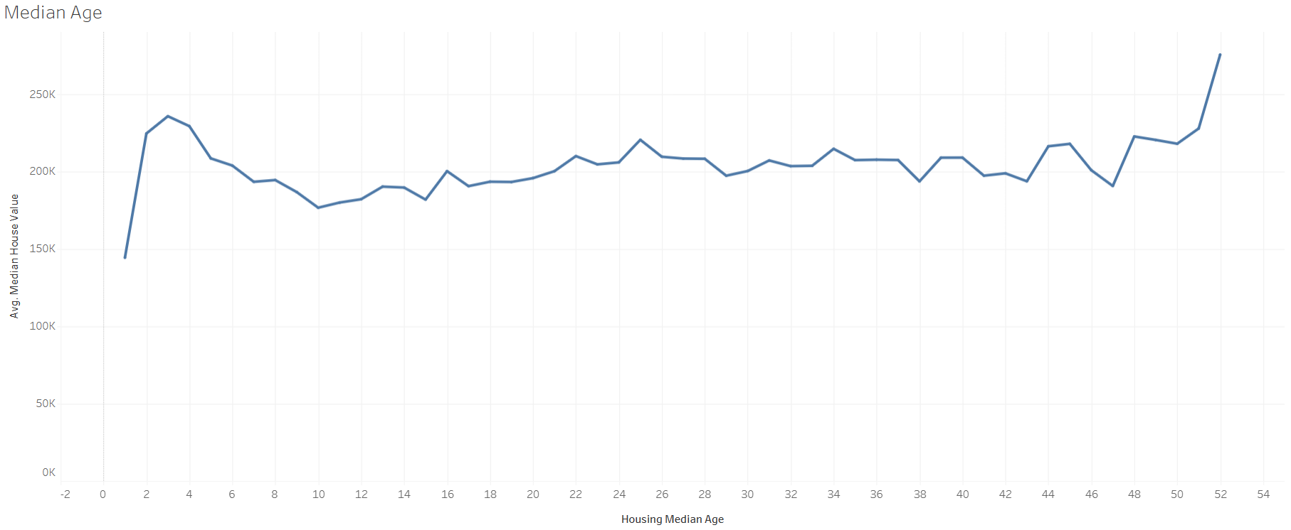
Median Household Age
Household age does not impact cost
Notes:
Drea
After seeing that housing costs were affected by proximity to the ocean or bay, we wanted to see if the age of the house had an influence on the cost. From this graph, at year 1 of the house being built, the price is low and peaks at year 2. From there, the cost of the houses slightly fluctuate, but does not significantly change over time. At age 51+, we do see an increase in average price.

Slide 11
Summary
Machine learning offers powerful tools for real estate investors to make data-driven decisions, assess property values, and identify investment opportunities. Here's how it can be beneficial:
Predicting Investment Potential:
Machine learning can predict whether a home is a good investment by analyzing historical data and market trends.
It helps investors identify properties with the potential for appreciation, rental income, or other financial gains.
Property Price Classification:
Investors can use machine learning to classify whether a house is priced correctly based on various factors.
This aids in negotiating deals and avoiding overpriced properties.
Finding Undervalued Homes:
Machine learning algorithms can sift through thousands of home listings, identifying underappreciated properties.
Investors can seize opportunities to purchase undervalued homes and potentially sell them for profit.
Machine learning empowers real estate investors with predictive capabilities, classification tools, and the ability to uncover hidden gems in the market. Whether you're looking to buy, sell, or hold, data-driven insights can enhance your investment strategy.
Notes:
Daisy

Slide 12
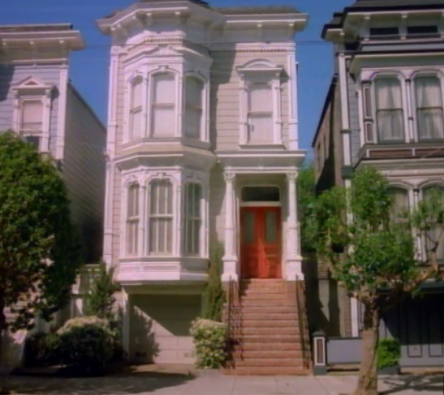
Thanks!
Questions?

